Slide 1
Scrum

Slide 2
What is Scrum?
A popular framework for managing web projects.
One of Agile's methodologies that allows focus on the delivery of
the most important values in the shortest possible time, from the
point of view of business.
An agile, lightweight process for managing and controlling software
and product development in rapidly changing environments.
Team-based approach.
Developing systems/ products with rapidly changing requirements.
It controls conflicting interests and looks for ways to improve communications
and maximize cooperation.

Slide 3
Scrum Overview

Slide 4
Scrum Framework
Roles
Product Owner
Scrum Master
Project Team
Ceremonies
Sprint planning
Sprint review
Sprint retrospective
Daily scrum meeting
Artifacts
Product Backlog
Sprint Backlog
Burndown charts

Slide 5







Scrum Roles
1) Product Owner (product image)
- understands how this product should look / work;
- doesn’t work in a team, he acts on the client's side (this can be
either another company and another department);
- sets priorities for tasks.
2) Scrum Master (effective organization)
- holds Scrum meetings;
- monitors compliance with all the principles of Scrum;
- resolves contradictions and protects the team from distractions.
3) Project Team (quality product)
- consisting of specialists of different profiles;
- typically 5-9 people;
- responsible, constantly, improving, self-organized, develops the
product of the highest quality.

Slide 6
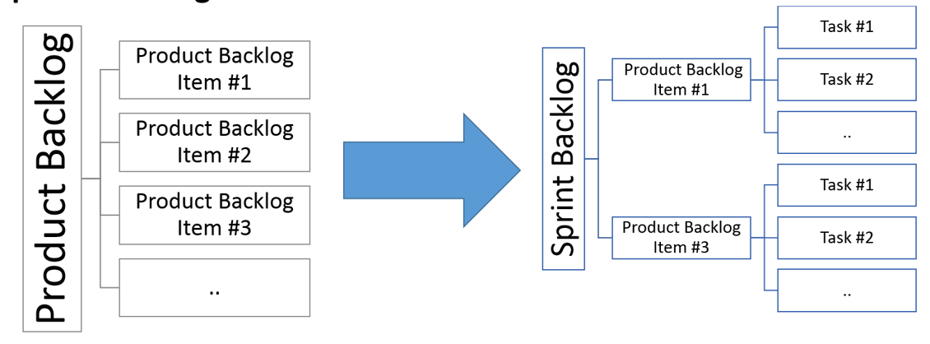
Scrum Artifacts
1) Product Backlog - list of requirements, wishes, stories,
functionality, which are ordered in order of importance (consists
of a user story). The Product Owner is responsible
for the Product Backlog.
2) Sprint Backlog - contains the functionality selected by
Product Owner of Product Backlog. All functions are divided by
tasks (Sprint Story Tasks), each of which is estimated by the team.

Slide 7
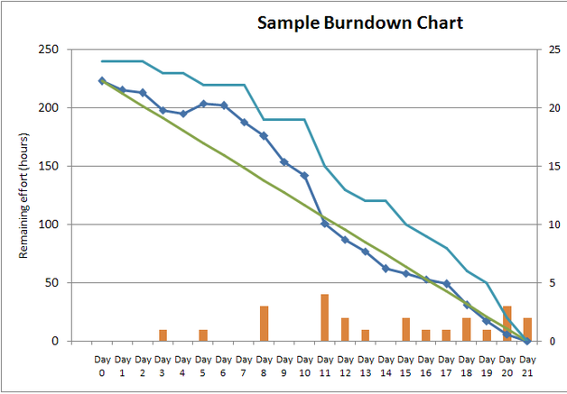
Scrum Artifacts
3) Burndown charts - a display of
what work has been completed and
what is left to complete:
- one for each developer or work item;
- updated every day;
make best guess about hours/points
completed each day.
Release burndown chart shows overall
progress updated at end of each sprint.

Slide 8
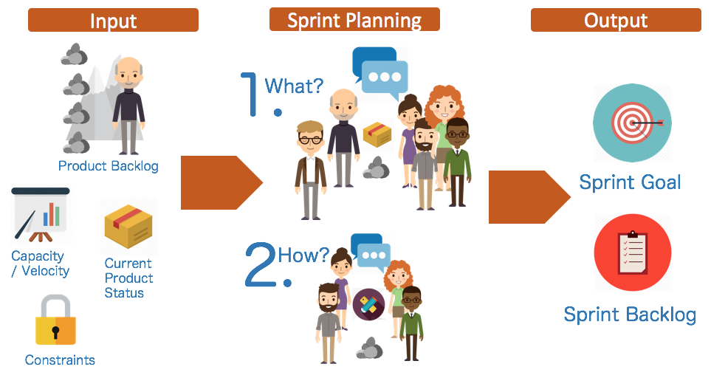
Scrum Ceremonies
1) Sprint planning - is a meeting where there are all (Product Owner, Scrum Master,
Project Team).
Purpose:
to determine the Sprint Goal and Sprint Backlog;
determine exactly how certain functionality will be developed to achieve the goal of the sprint;
for each element of Sprint Backlog a list of tasks is defined and their duration is estimated.

Slide 9
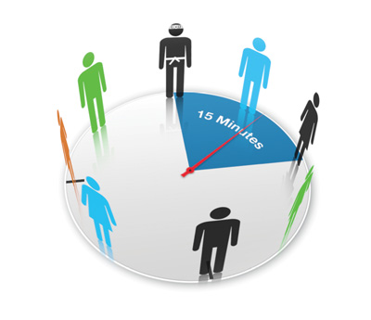
Scrum Ceremonies
2) Daily scrum meeting - update sprint status so that all team members knew who and
what is involved in the project.
15 minute time-boxed event for the Project Team to synchronize activities.
- What has been accomplished since last meeting?
- What will be done before the next meeting?
- What obstacles are in the way?

Slide 10

Scrum Ceremonies
3) Sprint review (demonstration) - feedback, display of results.
- Product Owner identifies what has been done;
- Project Team discusses what went well, what problems it ran into & those that were solved;
- Project Team demonstrates what it has done in a demo;
- Product Owner discusses the backlog as it stands;
- Entire group collaborates on what to do next.

Slide 11
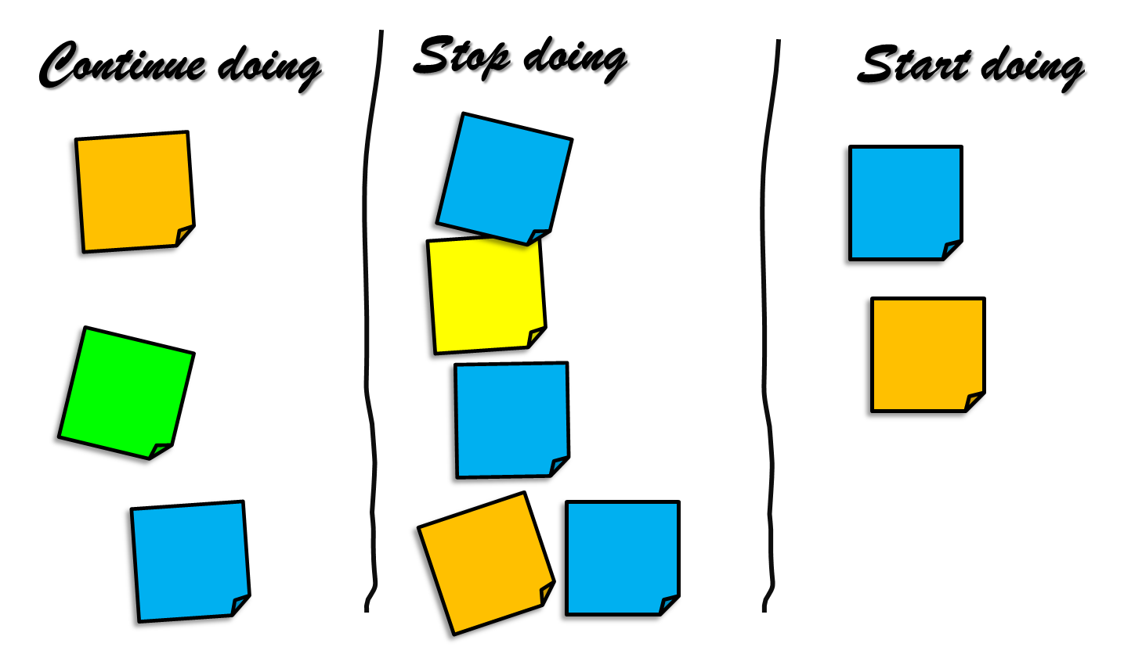
Scrum Ceremonies
4) Sprint retrospective - productivity increase.
- Inspect how the last Sprint went;
- Identify and order the major items that went well and potential improvements;
- Create a plan for implementing improvements?

Slide 12
Thank you!

